Slide 1
Lec 3: Operations on Signals (dependent Variable)
Dr. Arsla Khan

Slide 2
Operations on Signals
Operations with respect to x-axis (Time axis) / Transformations on the independent variable
Time Shifting
Time Reversal/Folding/Flipping
Time Scaling
Operations with respect to y-axis (Amplitude) / Transformations on the dependent variable
Amplitude Scaling
Addition and Subtraction
Multiplication and Division
Differentiation and Integration

Slide 3
Links for Video Lectures
Addition of CT signals
https://www.youtube.com/watch?v=TmkTwJT79yc&list=PLBlnK6fEyqRhG6s3jYIU48CqsT5cyiDTO&index=3
Multiplication of CT signals
https://www.youtube.com/watch?v=jPCgU4ghB8Q&list=PLBlnK6fEyqRhG6s3jYIU48CqsT5cyiDTO&index=4
Amplitude Scaling of CT signals
https://www.youtube.com/watch?v=sTHbXeiAB_c&list=PLBlnK6fEyqRhG6s3jYIU48CqsT5cyiDTO&index=6
Amplitude Shifting of CT signals
https://www.youtube.com/watch?v=sTHbXeiAB_c&list=PLBlnK6fEyqRhG6s3jYIU48CqsT5cyiDTO&index=6

Slide 4
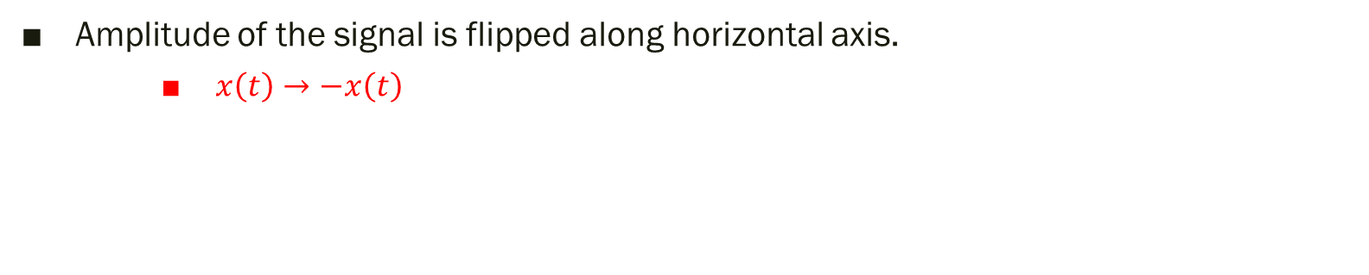

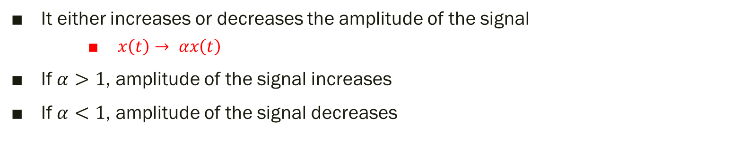



1) Amplitude Scaling
x(t)
It either increases or decreases the amplitude of the signal
$x\left(t\right)→ αx\left(t\right)$
If $α>1$, amplitude of the signal increases
If $α<1$, amplitude of the signal decreases
$α$x(t)
$α$x(t)
$$α=0.5$$
$$α=2$$
2) Amplitude Flipping
Amplitude of the signal is flipped along horizontal axis.
$x\left(t\right)→−x\left(t\right)$

Slide 5
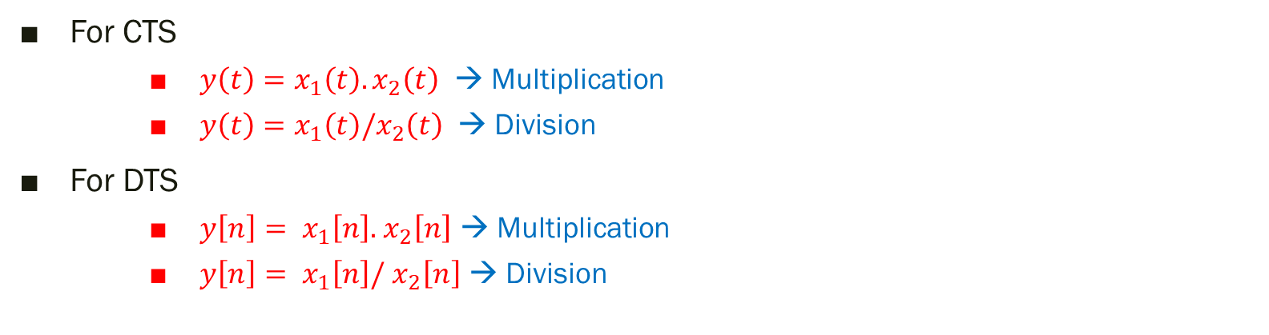
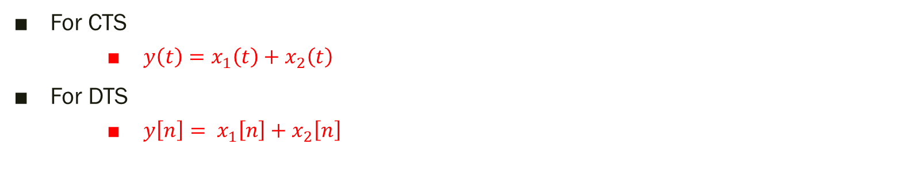
3) Addition and Subtraction
For CTS
$y\left(t\right)=x_{1}\left(t\right)+x_{2}\left(t\right)$
For DTS
$y\left[n\right]= x_{1}\left[n\right]+$ $x_{2}\left[n\right]$
4) Multiplication and Division
For CTS
$y\left(t\right)=x_{1}\left(t\right).x_{2}\left(t\right)$ → Multiplication
$y\left(t\right)=x_{1}\left(t\right)/x_{2}\left(t\right)$ → Division
For DTS
$y\left[n\right]= x_{1}\left[n\right].$ $x_{2}\left[n\right]$ → Multiplication
$y\left[n\right]= x_{1}\left[n\right]/$ $x_{2}\left[n\right]$ → Division

Slide 6
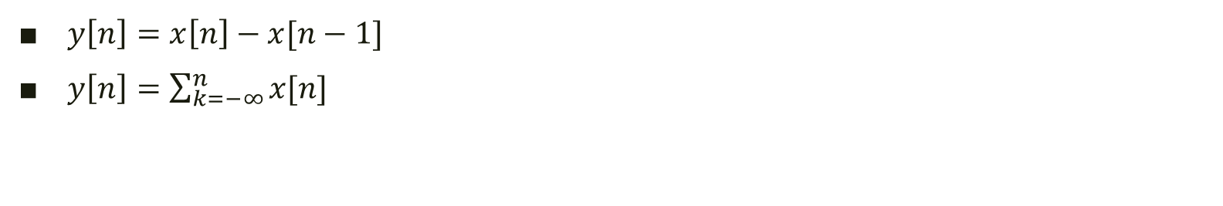
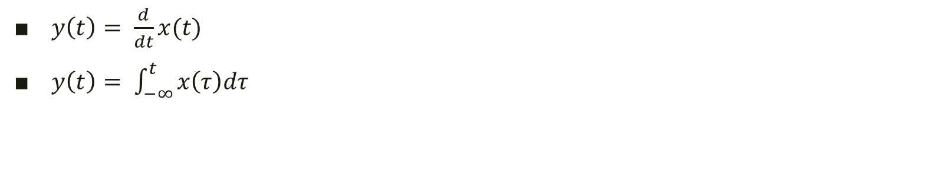
5) Differentiation and Integration → Only for CTS
$y\left(t\right)= \frac{d}{dt}x(t)$
$y\left(t\right)= \int_{−∞}^{t}{x\left(τ\right)dτ}$
6) Difference and Accumulation → Only for DTS
$y\left[n\right]=x\left[n\right]−x[n−1]$
$y\left[n\right]=\sum_{k=−∞}^{n}{x[n]}$

Slide 7
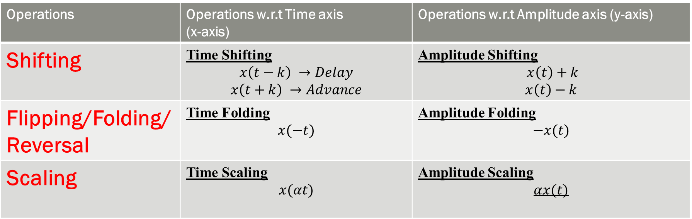
Operations | Operations w.r.t Time axis (x-axis) | Operations w.r.t Amplitude axis (y-axis)
Shifting | Time Shifting $$x\left(t−k\right) →Delay$$ $$x\left(t+k\right) →Advance$$ | Amplitude Shifting $x\left(t\right)+k$ $$x\left(t\right)−k$$
Flipping/Folding/Reversal | Time Folding $$x(−t)$$ | Amplitude Folding $$−x(t)$$
Scaling | Time Scaling $$x(αt)$$ | Amplitude Scaling $$αx(t)$$

Slide 8
Operations w.r.t y-axis (amplitude) for DTS
Operations w.r.t y-axis i.e. amplitude axis for DTS are performed sample by sample basis.

Slide 9
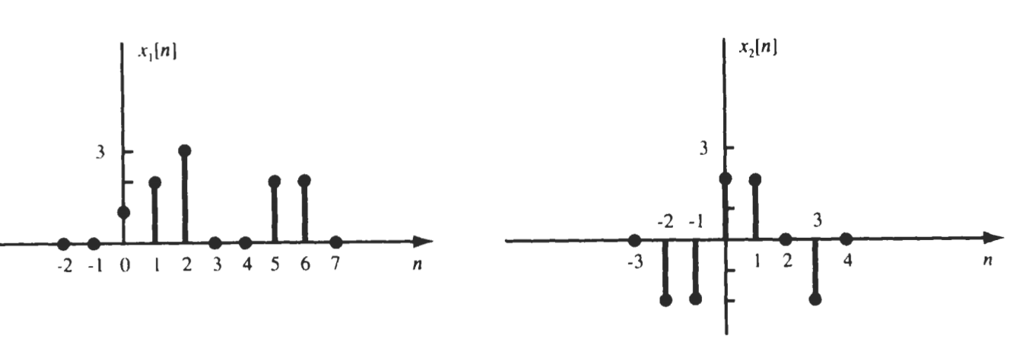

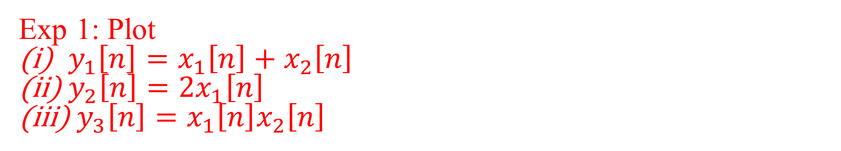
Exp 1: Plot
$y_{1}\left[n\right]=x_{1}\left[n\right]+x_{2}\left[n\right]$
$y_{2}\left[n\right]={2x}_{1}\left[n\right]$
${ y}_{3}\left[n\right]=x_{1}\left[n\right]x_{2}\left[n\right]$
How to write DTS ???
$x_{1}\left[n\right]=\{0,0,1,2,3,0,0,2,2,0\}$
$x_{2}\left[n\right]=\{0,−2,−2,2,2,0,−2,0\}$
Position of sample at zeroth place
Position of sample at zeroth place

Slide 10
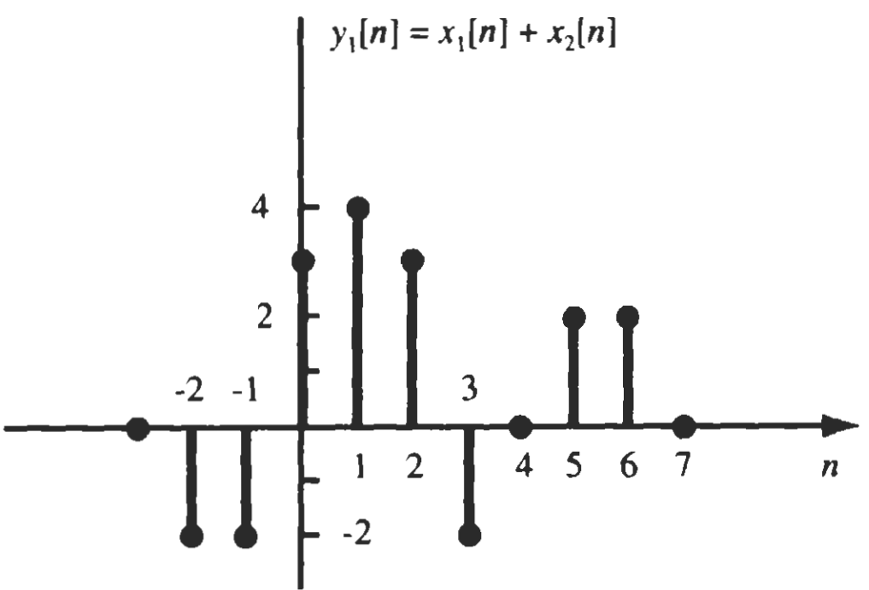
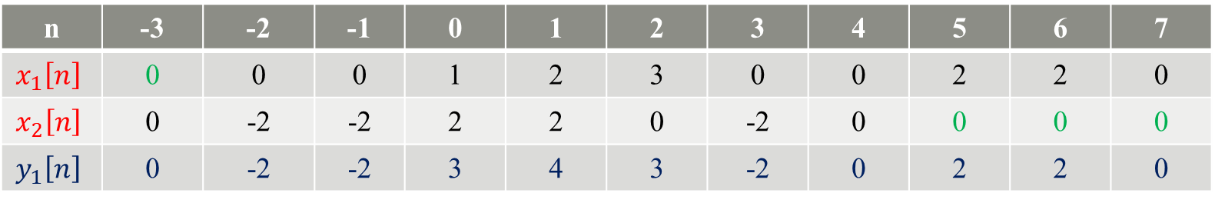
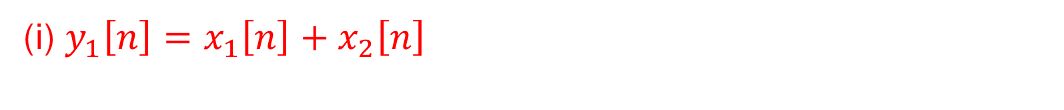
(i) $y_{1}\left[n\right]=x_{1}\left[n\right]+x_{2}\left[n\right]$
n | -3 | -2 | -1 | 0 | 1 | 2 | 3 | 4 | 5 | 6 | 7
$$x_{1}\left[n\right]$$ | 0 | 0 | 0 | 1 | 2 | 3 | 0 | 0 | 2 | 2 | 0
$$x_{2}\left[n\right]$$ | 0 | -2 | -2 | 2 | 2 | 0 | -2 | 0 | 0 | 0 | 0
$$y_{1}\left[n\right]$$ | 0 | -2 | -2 | 3 | 4 | 3 | -2 | 0 | 2 | 2 | 0

Slide 11
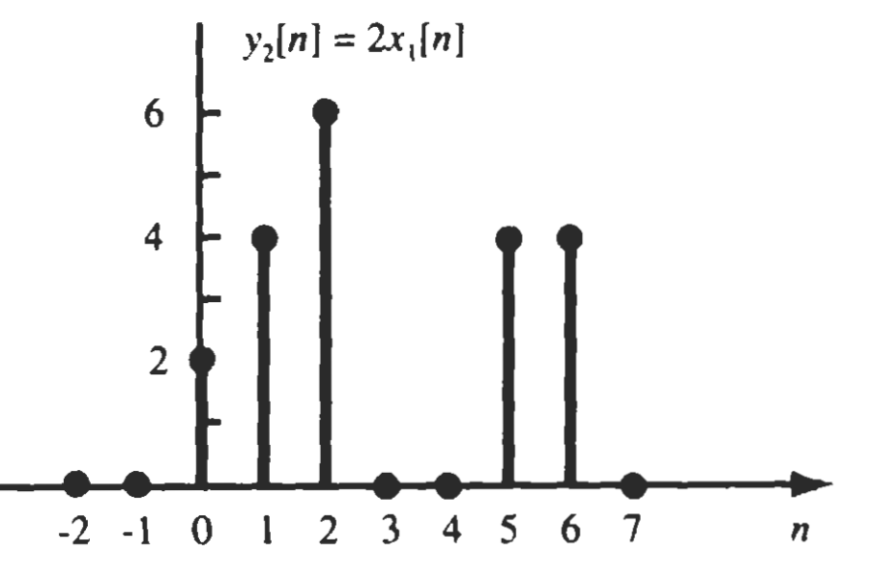
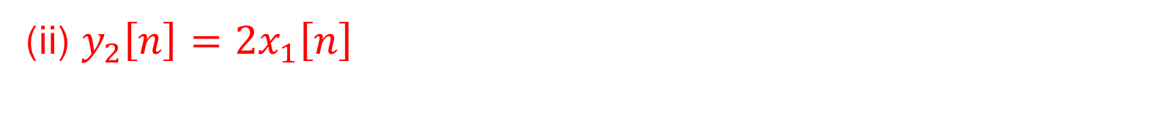
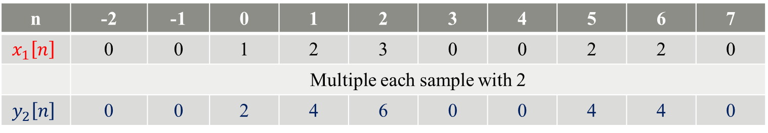
(ii) $y_{2}\left[n\right]={2x}_{1}\left[n\right]$
n | -2 | -1 | 0 | 1 | 2 | 3 | 4 | 5 | 6 | 7
$$x_{1}\left[n\right]$$ | 0 | 0 | 1 | 2 | 3 | 0 | 0 | 2 | 2 | 0
 | Multiple each sample with 2
$$y_{2}\left[n\right]$$ | 0 | 0 | 2 | 4 | 6 | 0 | 0 | 4 | 4 | 0

Slide 12
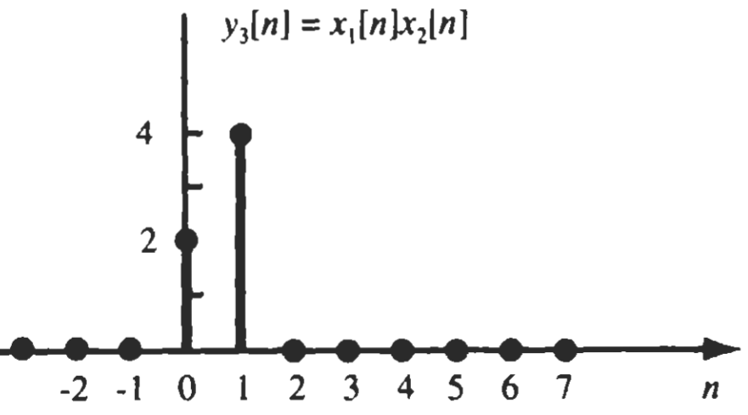
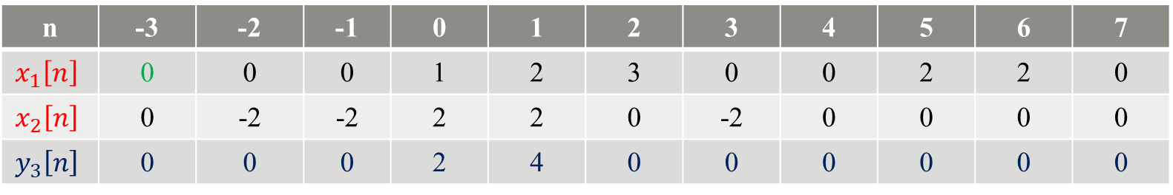
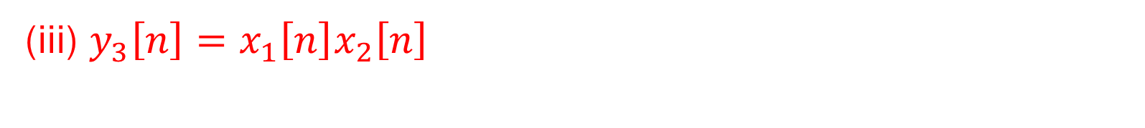
(iii) $y_{3}\left[n\right]=x_{1}\left[n\right]x_{2}\left[n\right]$
n | -3 | -2 | -1 | 0 | 1 | 2 | 3 | 4 | 5 | 6 | 7
$$x_{1}\left[n\right]$$ | 0 | 0 | 0 | 1 | 2 | 3 | 0 | 0 | 2 | 2 | 0
$$x_{2}\left[n\right]$$ | 0 | -2 | -2 | 2 | 2 | 0 | -2 | 0 | 0 | 0 | 0
$$y_{3}\left[n\right]$$ | 0 | 0 | 0 | 2 | 4 | 0 | 0 | 0 | 0 | 0 | 0

Slide 13
Operations w.r.t y-axis for CTS
It is preferable to write mathematical representation of signals before applying operations on CTS w.r.t y-axis.
Mathematical Definition of Signals
CTS are defined in the form of their ranges

Slide 14
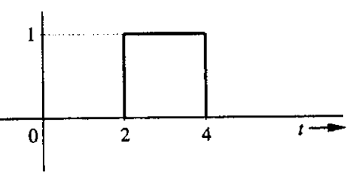
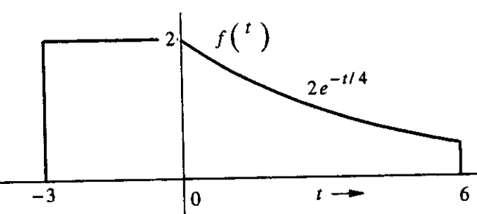
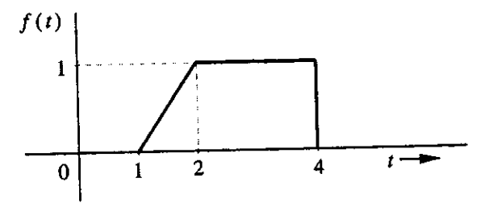

x(t)
$x\left(t\right)=\left\{\begin{aligned}\begin{matrix}1 & 2≤t≤4\end{matrix} \\ \begin{matrix}0 & Otherwise\end{matrix}\end{aligned}\right.$
$f\left(t\right)=\left\{\begin{aligned}\begin{matrix}2 & −3≤t≤0\end{matrix} \\ \begin{matrix}2e^{−t/4} & 0<t≤6\end{matrix} \\ \begin{matrix}0 & Otherwise\end{matrix}\end{aligned}\right.$
$f\left(t\right)= \left\{\begin{aligned}\begin{matrix}??? & 1≤t≤2\end{matrix} \\ \begin{matrix}1 & 2<t≤4\end{matrix} \\ \begin{matrix}0 & Otherwise\end{matrix}\end{aligned}\right.$

Slide 15

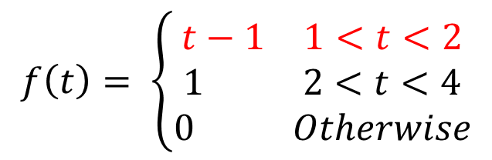
How to define ramp signal?
B (2,1)
Define points in which ramp exists
Point A ($x_{1},y_{1}$) = (1,0)
Point B ($x_{2},y_{2}$) = (2,1)
Write equation for line and put values
$\frac{y−y_{1}}{y_{2}−y_{1}}=\frac{x−x_{1}}{x_{2}−x_{1}}$
$\frac{y−0}{1−0}=\frac{x−1}{2−1}$
$y=x−1$
Replace $x$ with $t$ and $y$ with $f(t)$
$∴f\left(t\right)=t−1$
A (1,0)
$$f\left(t\right)= \left\{\begin{aligned}\begin{matrix}t−1 & 1<t<2\end{matrix} \\ \begin{matrix}1 & 2<t<4\end{matrix} \\ \begin{matrix}0 & Otherwise\end{matrix}\end{aligned}\right.$$

Slide 16
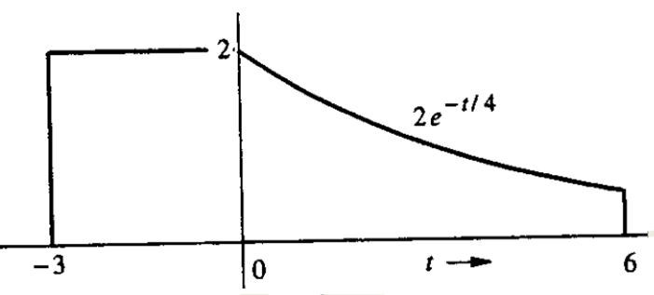
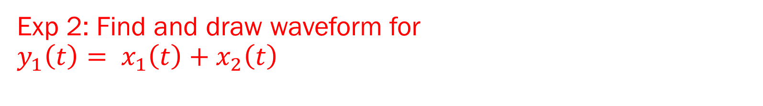


Exp 2: Find and draw waveform for $$y_{1}\left(t\right)= x_{1}\left(t\right)+x_{2}\left(t\right)$$
$$x1(t)$$
$$x2(t)$$

Slide 17
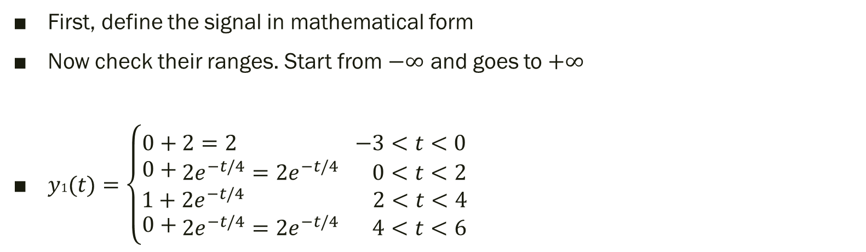

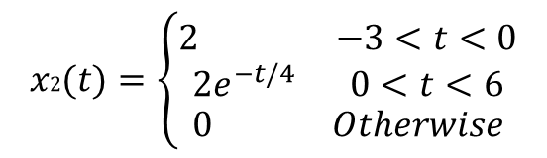
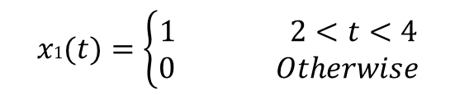

$$x2(t)$$
$$x1(t)$$
$$x1(t)=\left\{\begin{aligned}\begin{matrix}1 & 2<t<4\end{matrix} \\ \begin{matrix}0 & Otherwise\end{matrix}\end{aligned}\right.$$
$$x2(t)=\left\{\begin{aligned}\begin{matrix}2 & −3<t<0\end{matrix} \\ \begin{matrix}2e^{−t/4} & 0<t<6\end{matrix} \\ \begin{matrix}0 & Otherwise\end{matrix}\end{aligned}\right.$$
First, define the signal in mathematical form
Now check their ranges. Start from $−∞$ and goes to $+∞$
$y1(t)=\left\{\begin{aligned}\begin{matrix}0+2=2 & −3<t<0\end{matrix} \\ 0+\begin{matrix}2e^{−t/4}=2e^{−t/4} & 0<t<2\end{matrix} \\ \begin{matrix}1+2e^{−t/4} & 2<t<4\end{matrix} \\ 0+\begin{matrix}2e^{−t/4}=2e^{−t/4} & 4<t<6\end{matrix}\end{aligned}\right.$
Now you can draw it

Slide 18
Thank You !!!

